Slide 1
Visual Texture
Analysis and Perception
Thrasos Pappas
Electrical & Computer Engineering
Northwestern University
Spring 2026

Slide 2

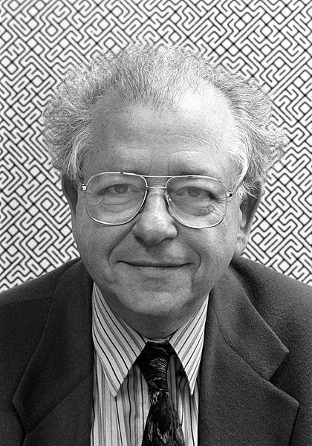
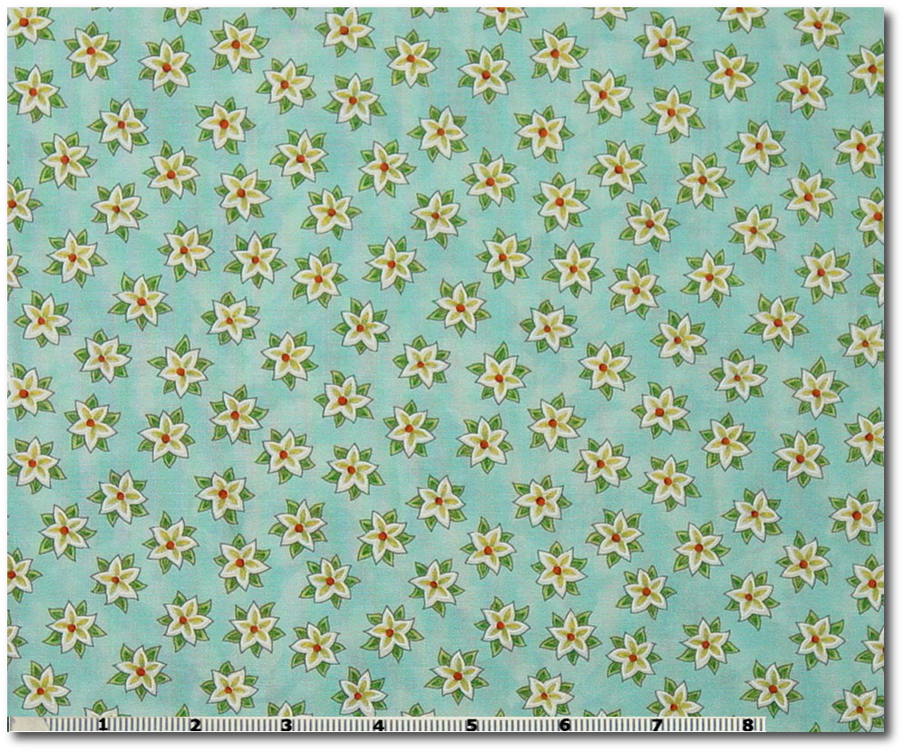
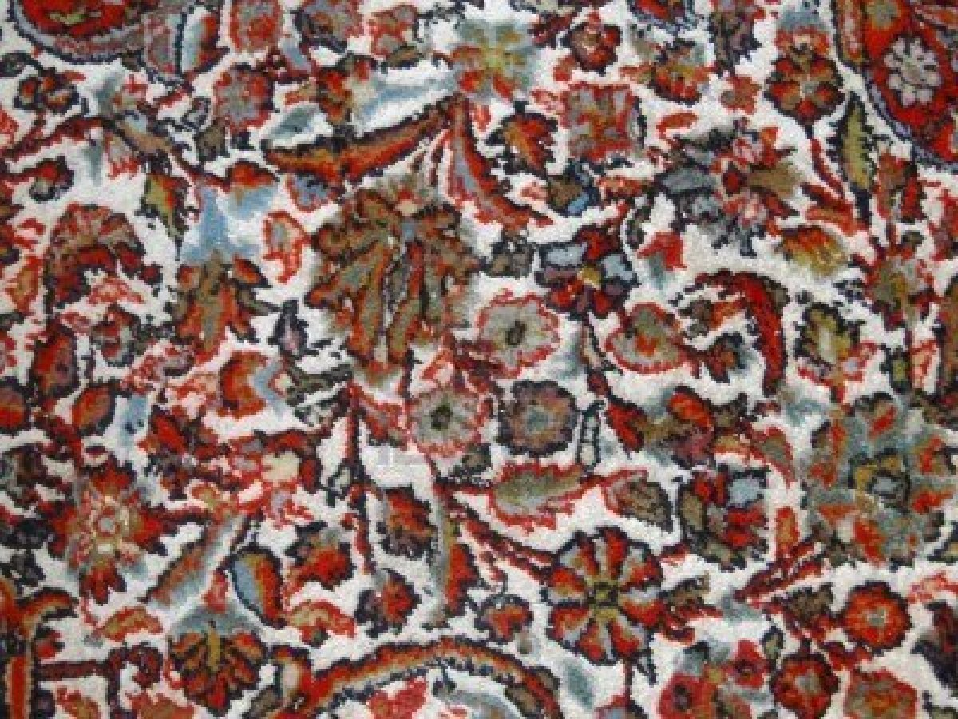

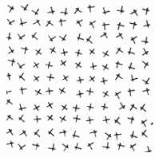

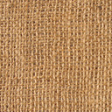
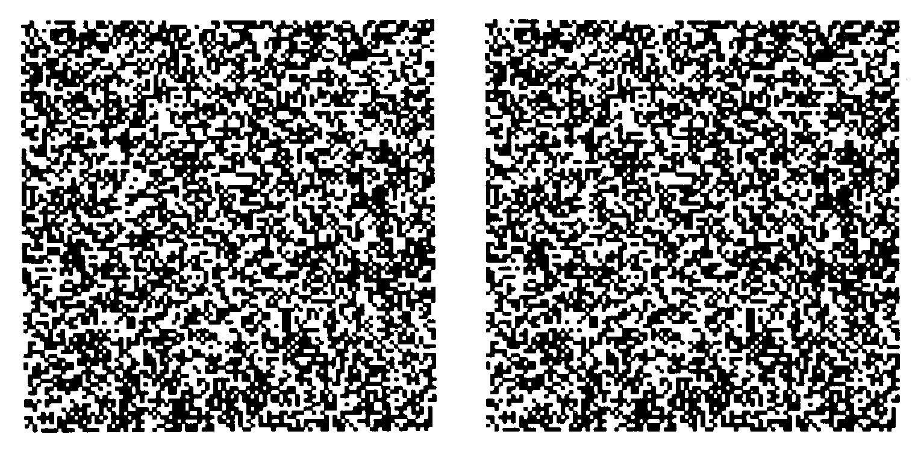
What is Texture?

Slide 3

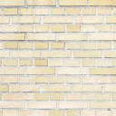
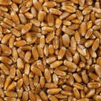
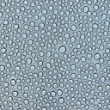



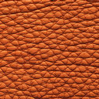
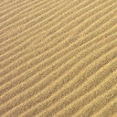
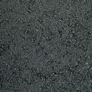
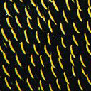
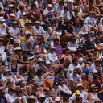

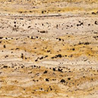


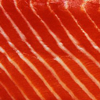

What is Texture?
“An image of visual texture is spatially homogeneous and typically contains repeated structures, often with some random variation (e.g., random positions, orientations or colors).” [Portilla & Simoncelli]

Slide 4


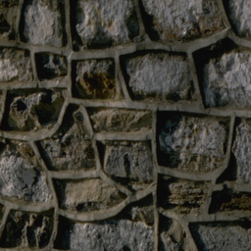



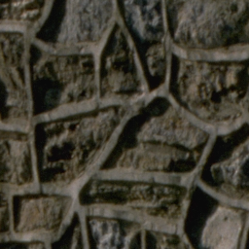

Texture Similarity

Slide 5
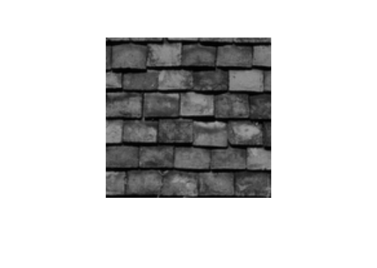
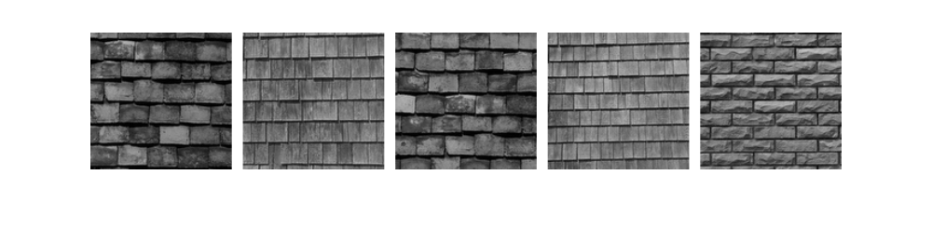
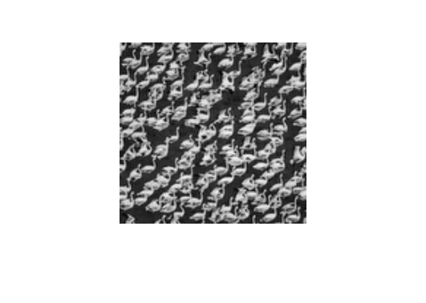
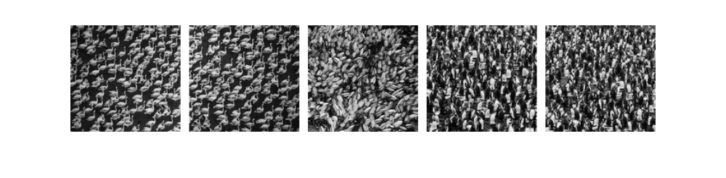
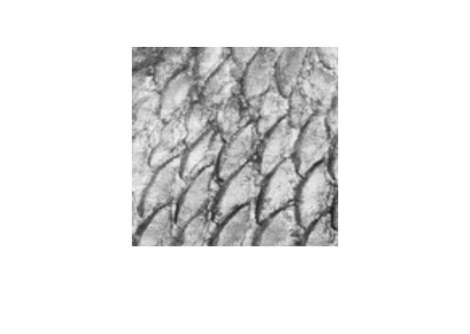
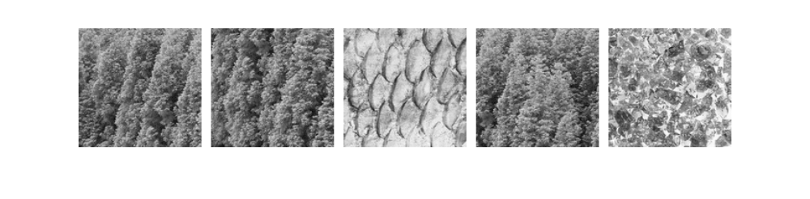
Content-Based Retrieval
Find the texture that is most similar to a query texture

Slide 6
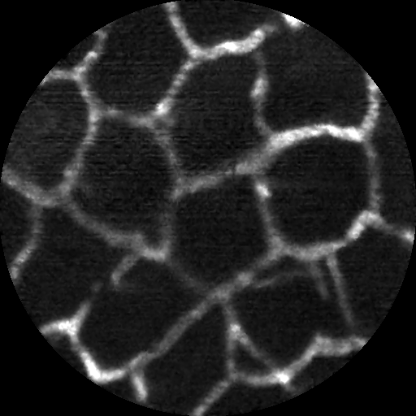
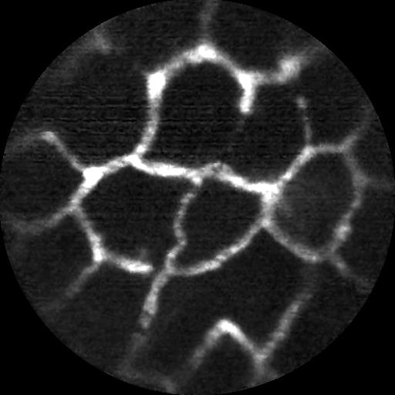
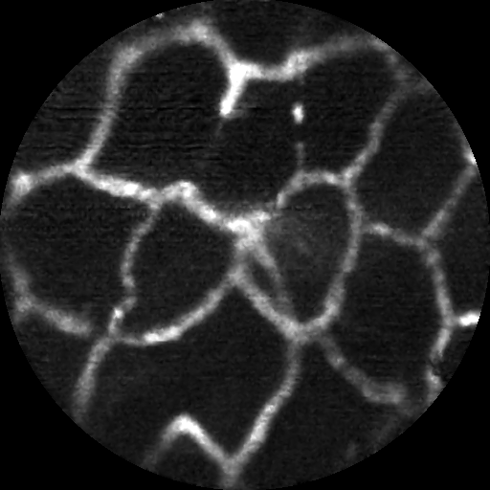
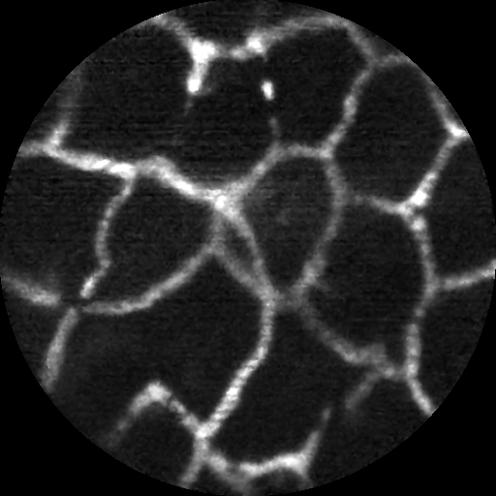
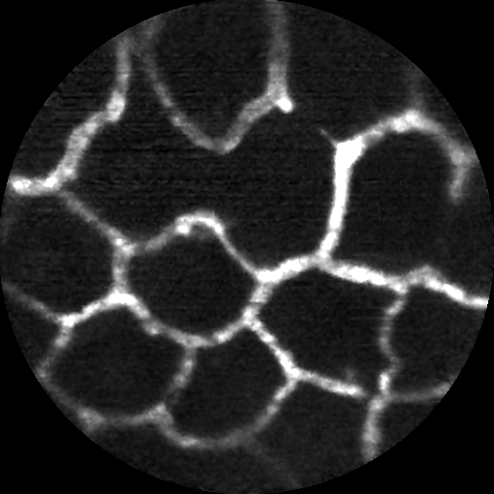
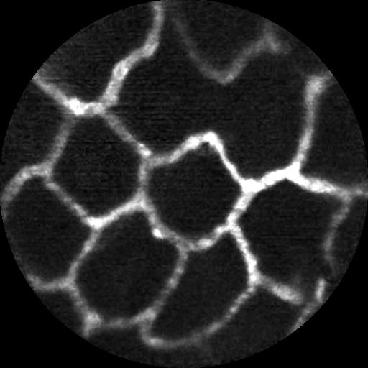
Microvascular Image Classification
Control Mucosa Images – Sarah Ruderman

Slide 7
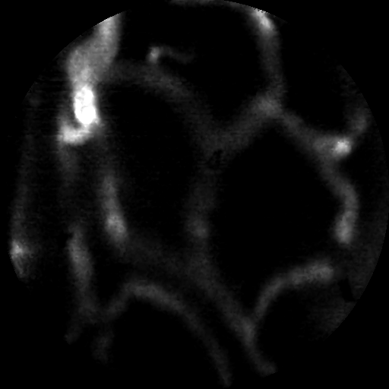
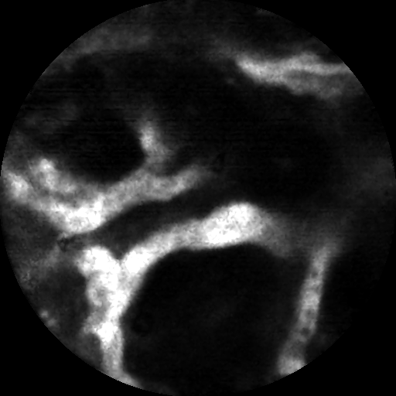
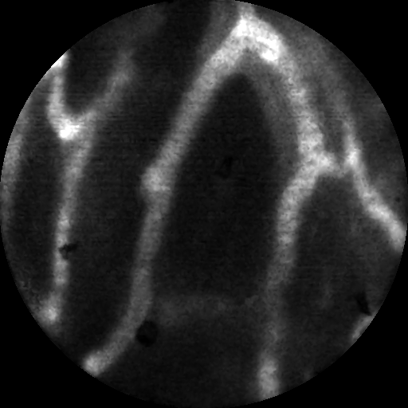
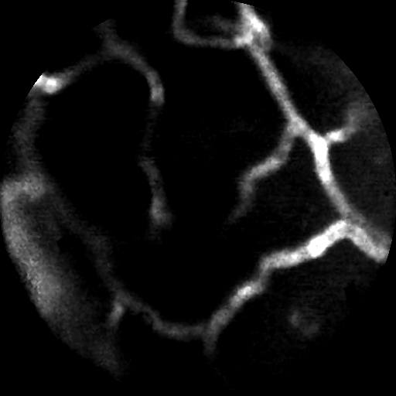
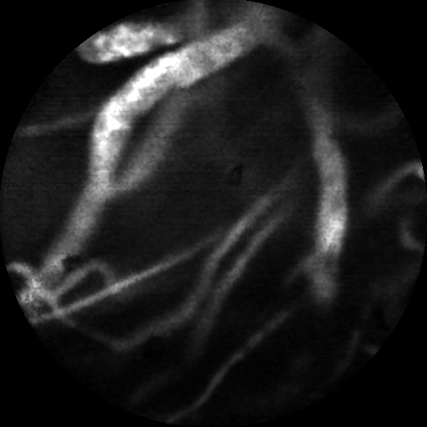
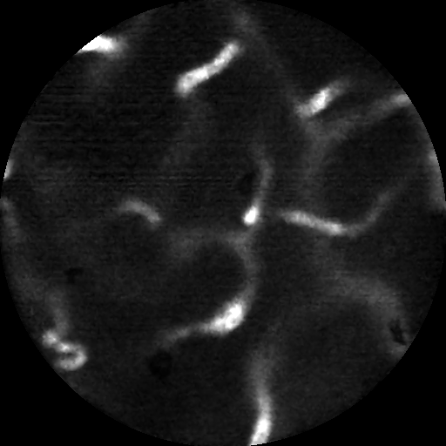
Microvascular Image Classification
Tumor Vasculature Images – Sarah Ruderman

Slide 8


Structurally Lossless Compression
Original
Matched-Texture Coding, 0.34 bpp
Jin, Zhai, Pappas, Neuhoff, ICIP’12

Slide 9

Structurally Lossless Compression
JPEG, 0.34 bpp
Matched-Texture Coding, 0.34 bpp
Jin, Zhai, Pappas, Neuhoff, ICIP’12

Slide 10
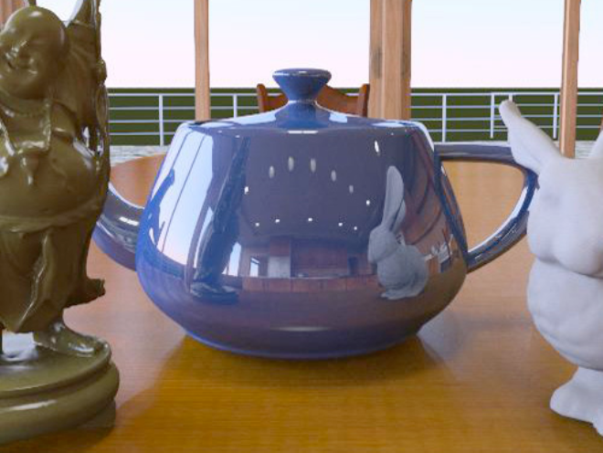
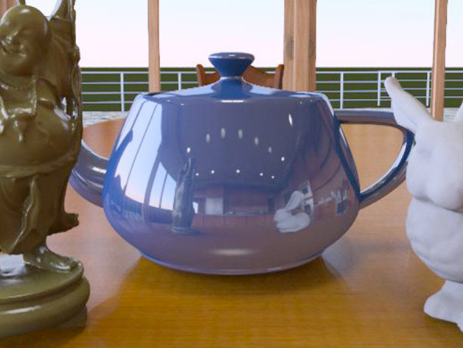
Visual Equivalence in Graphics
Path-traced
Environment-mapped
Visibly different, similar in (high) quality
Ramanarayanan, Ferwerda, Walter, Bala, “Visual Equivalence: Towards a New Standard for Image Fidelity,” ACM Tr. Graphics’07
Ferwerda, Ramanarayanan, Walter, Bala, “Visual Equivalence: Object Baased Approach to Image Quality,” Color Imaging Conf.’08

Slide 11
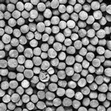
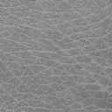
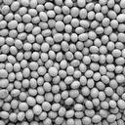
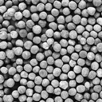
Texture Similarity
PSNR
11.3
9.0
8.2
1
9
10
Subjective

Slide 12
Texture Similarity
STSIM-2
0.83
0.96
0.98
1
9
10
Subjective

Slide 13
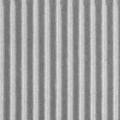
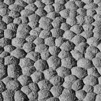
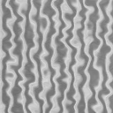
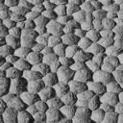
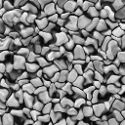
Texture Similarity – PSNR?
17.5
17.4
8.2
10.4

Slide 14
Texture Similarity – STSIM-2
0.83
0.987
0.978
0.96

Slide 15

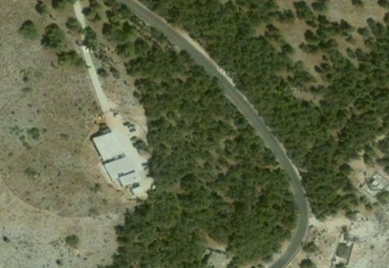
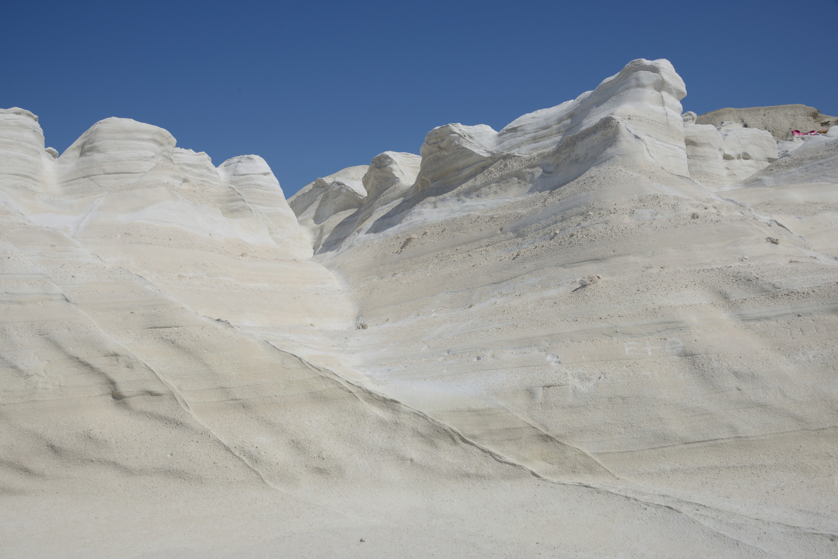
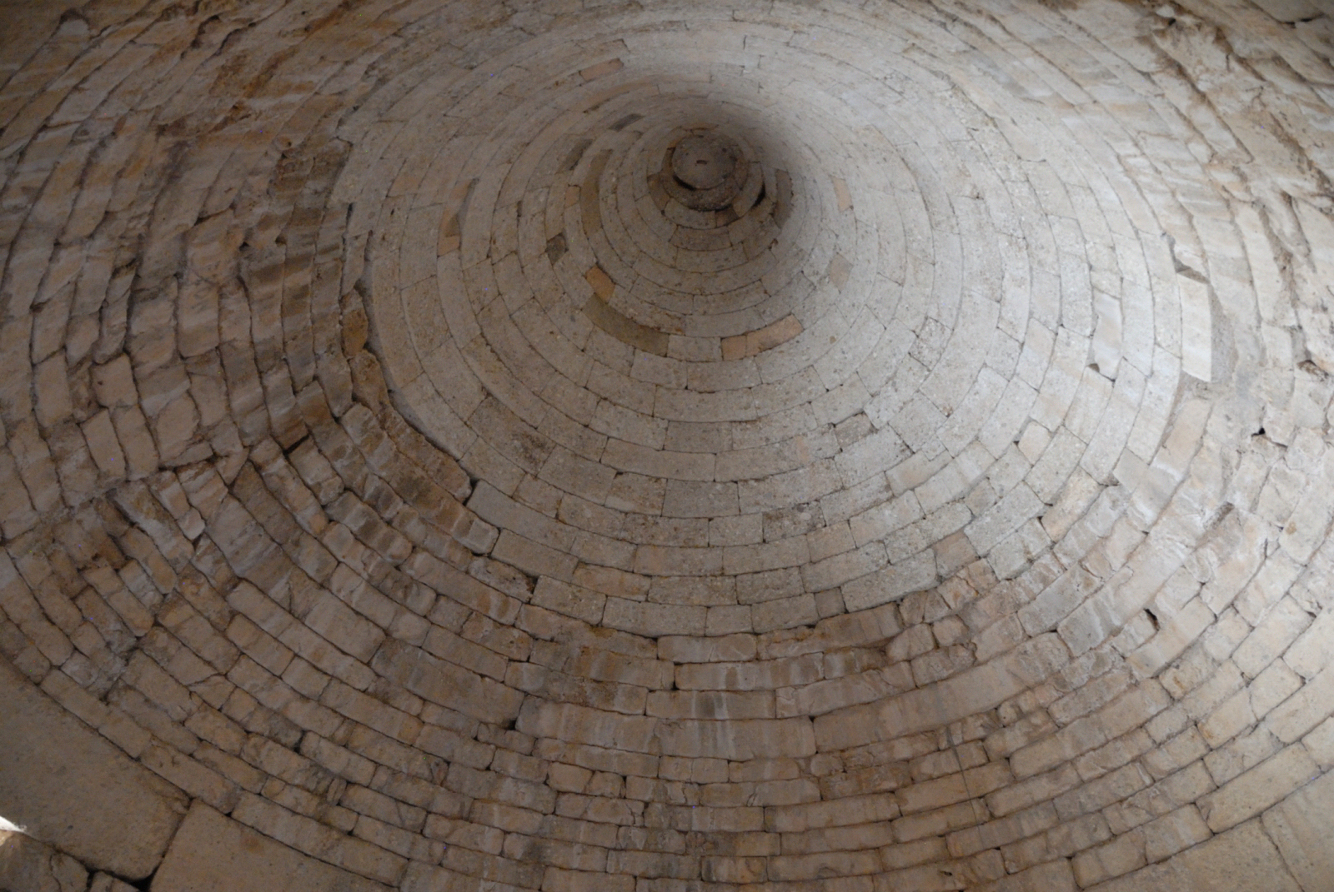

Visual Texture
Boundary detection, foreground/background separation
Shape from texture

Slide 16
Material Identification
Forest
Steel
Grains
Marble
Leather

Slide 17










Material Identification
Same material, different lighting and viewing conditions
Different materials

Slide 18

Material Identification
CUReT database
D. Nguyen, PhD Thesis, NU 2017

Slide 19





Material Properties
Dry
Soft
Slippery
Dirty
Fresh
Texture appearance depends on
  Material reflectance, absorbance
  Surface geometry
  Lighting
  Viewing angle
Difficult to separate
  “Inverse Optics” approach: Computationally intensive
  “Ecological” approach: Rely on natural texture statistics
  Fast, works most of the time, but … can make errors (visual illusions)

Slide 20


Material Properties: Skin Gloss
Macro-scale
Meso-scale
Amway database
25 subjects

Slide 21
Objective Measures of Gloss
Human skin gloss perception influenced by both surface and subsurface reflection
Polarization photography to separate them
Extract statistical texture features
  From surface and subsurface components
  Machine learning for predicting perceived gloss
  85% accuracy of prediction across subjects
J. Wang, et al., HVEI’ 17, HVEI’ 18, TIP-21

Slide 22

Texture Synthesis with StyleGAN

Slide 23

Texture Synthesis with StyleGAN

Slide 24















StyleGAN3 vs. Portilla-Simoncelli
original textures
styleGAN3 analysis/synthesis
Portilla/Simoncelli analysis/synthesis

Slide 25














StyleGan3 vs. Portilla-Simoncelli
original textures
styleGAN3 analysis/synthesis
Portilla/Simoncelli analysis/synthesis

Slide 26




Texture Color Composition
original
dominant colors
color composition
synthetic
Does color composition depend on the structure?
J. Wang, et al., JPI’ 20

Slide 27
Texture Color Composition
Significant impact of pattern scale and shape on perceived color amount

Slide 29


Slide 30



Visual to Tactile Mapping
Original Color Image
Segmentation
Tactile Display
Present a picture as a collection of segments with different tactile textures
Perceptually distinct tactile textures
Haptic space perception and scene perception
  Advantages over line drawings

Slide 31

Thank you
Questions?

