Slide 1

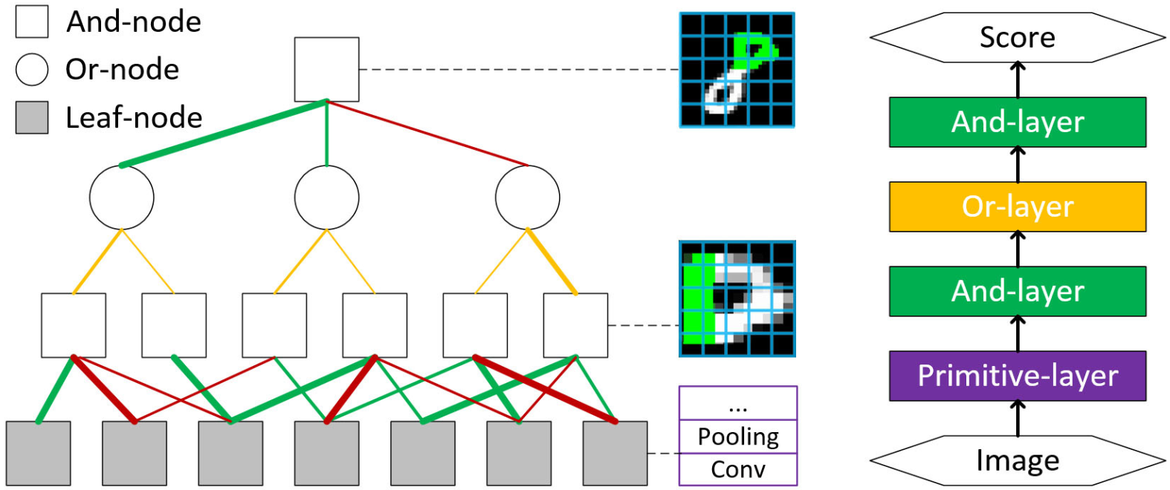
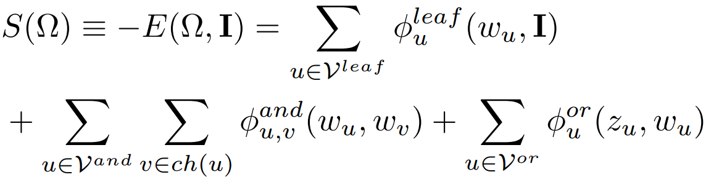
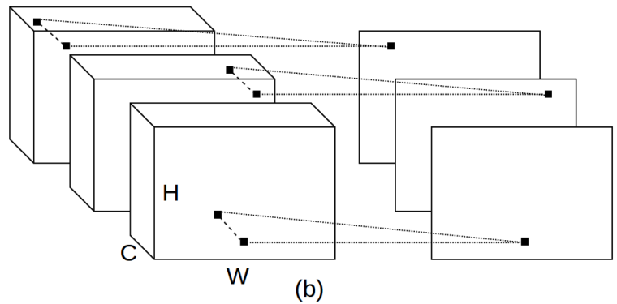
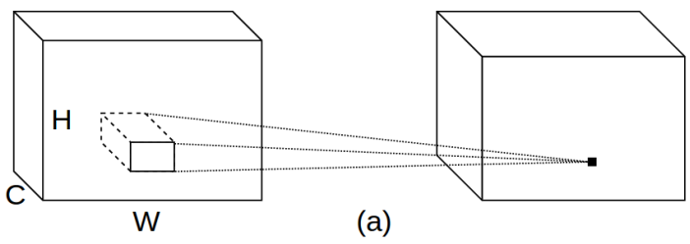
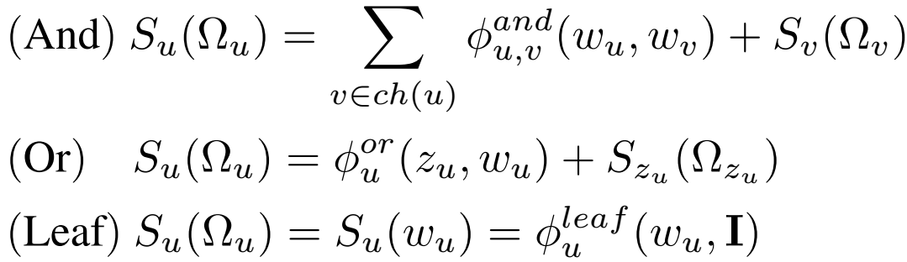
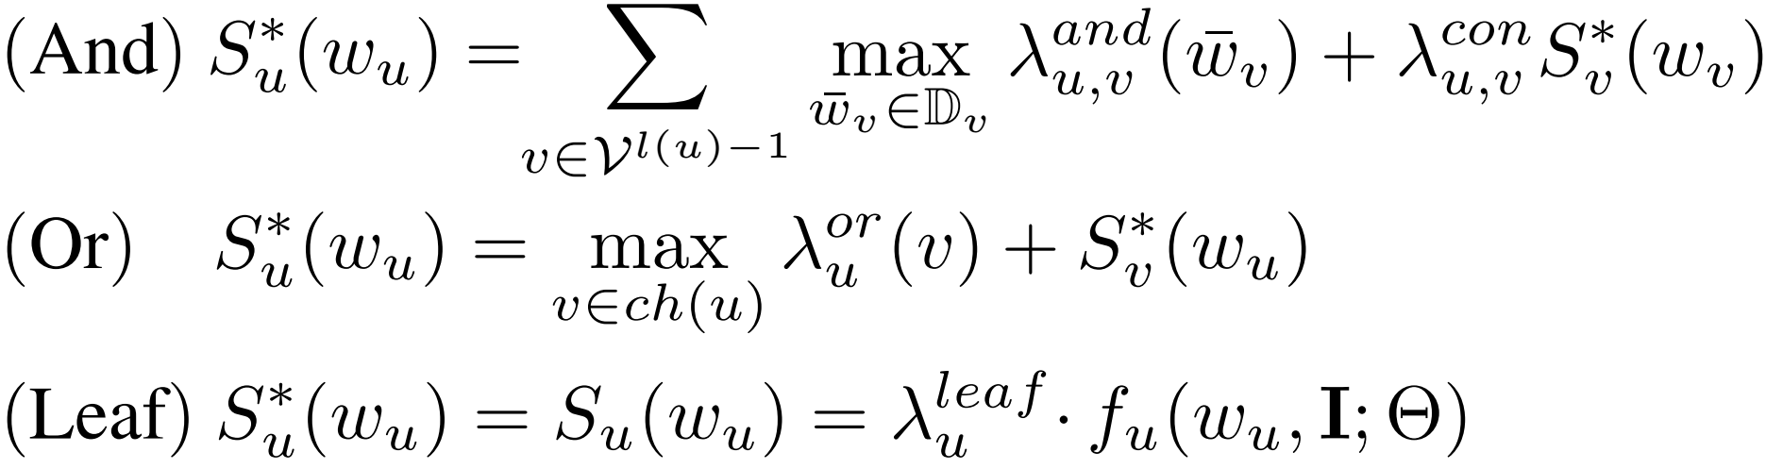
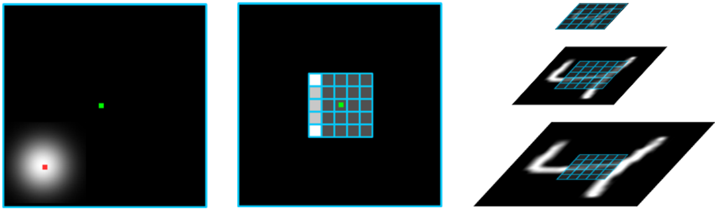
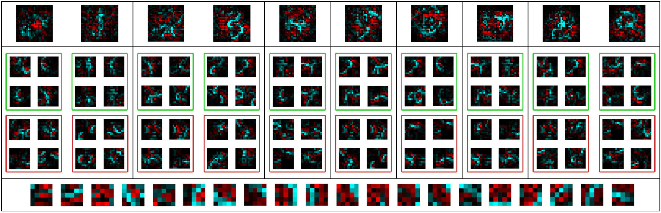
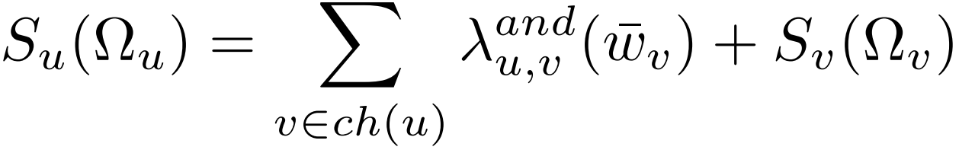
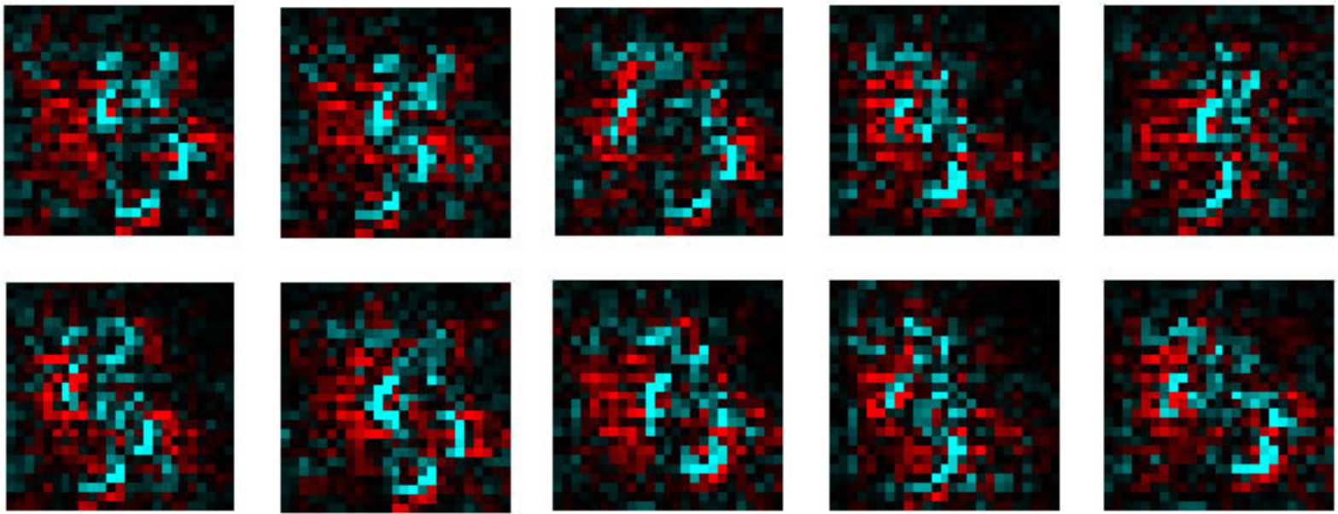
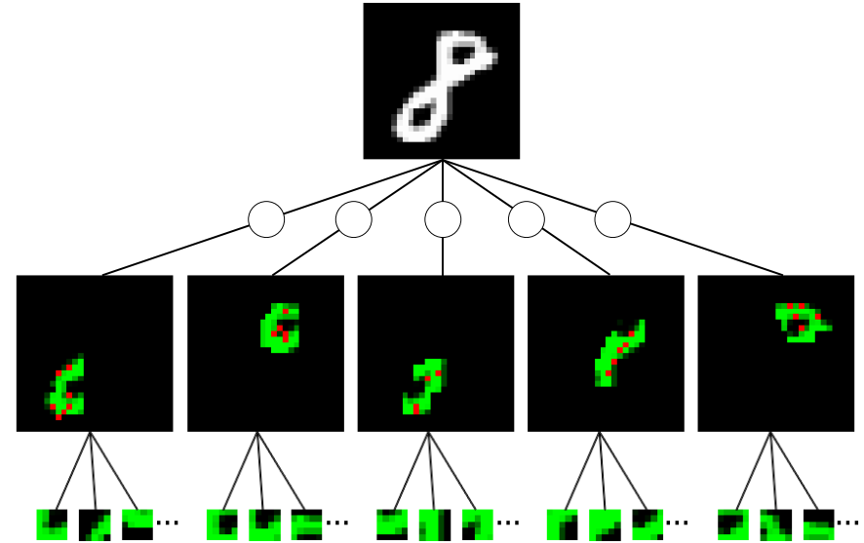
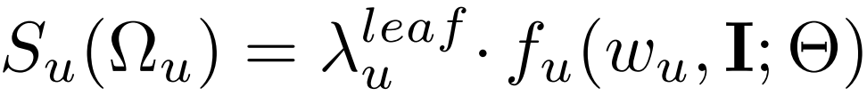
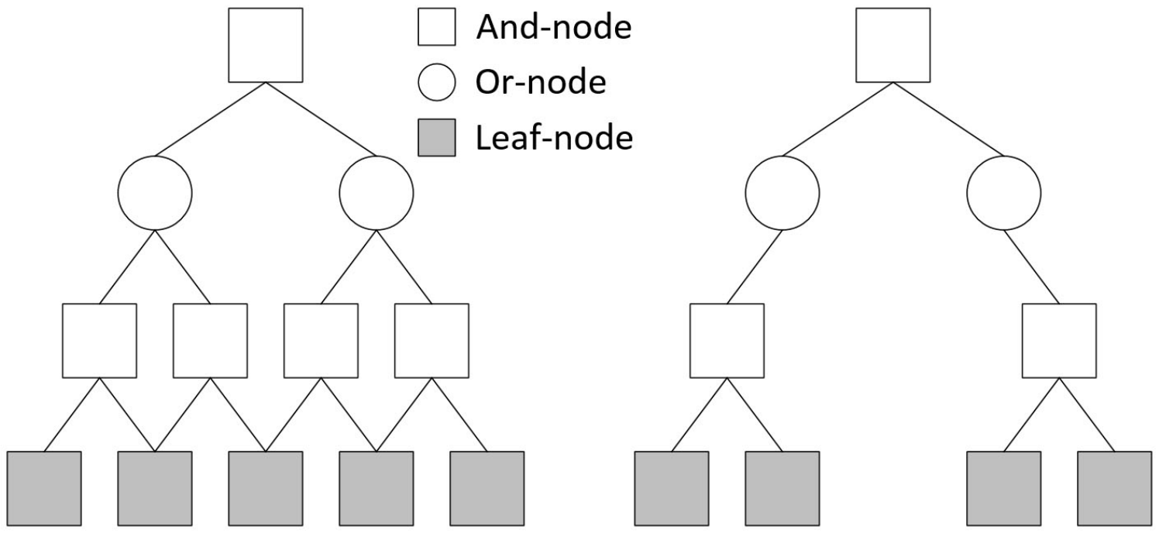
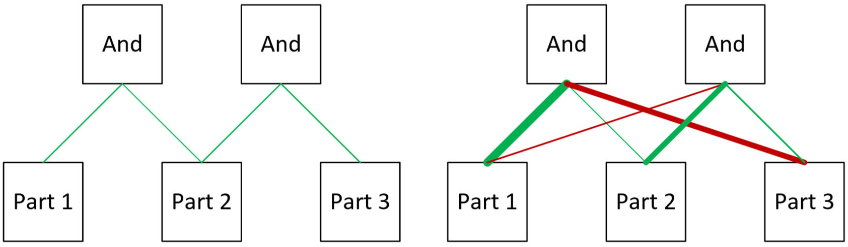
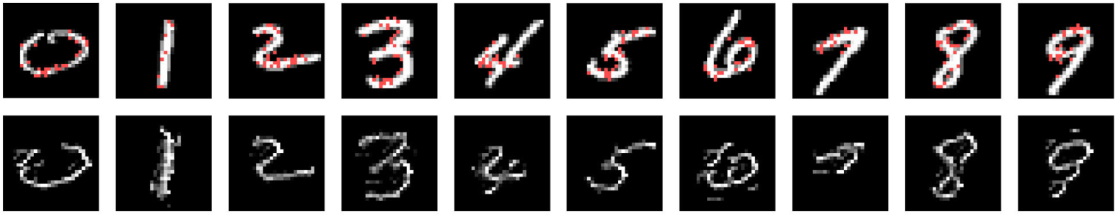
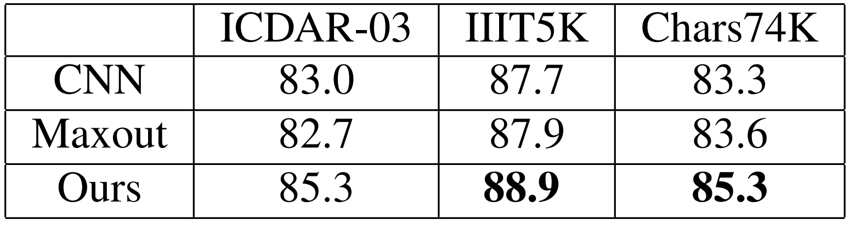
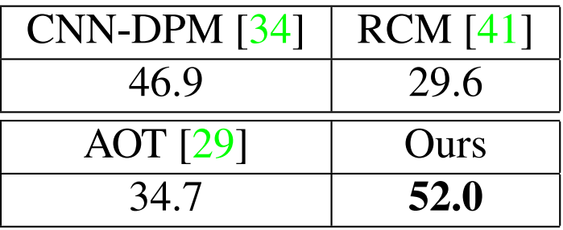
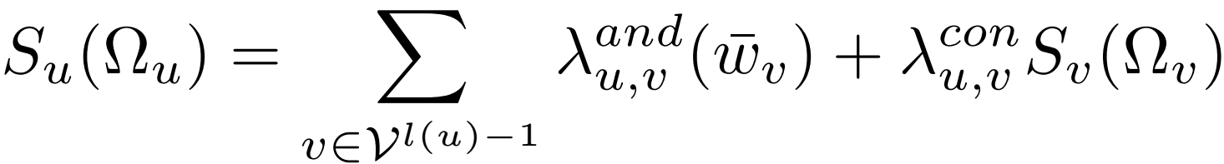
Towards a Unified Compositional Model for Visual Pattern Modeling
Wei Tang, Pei Yu, Jiahuan Zhou and Ying Wu
Overview
Node Modeling
Inference as a Feedforward Network
Scoring function of an AOG:
S(Ω) can be computed recursively via node models:
The update rules of dynamic programming can be considered as And/Or/Primitive-layers. Thus all the parameters can be learned end-to-end via BP.
Motivations
While compositionality is attractive to vision modeling, current compositional models have some problems.
Manually designed compositional architectures.
Separation of structure and part discovery from learning.
Latent structural learning is difficult to scale up.
Experiments
Our And-node characterizes the subpart-part compositions in a local window and involves longer- range contexts via multiscale modeling.
Bottom-up composition of filters on MNIST
Contributions
The first framework to unify the following key ingredients in compositional modeling: structure, parts, features and composition/sub-configuration relations.
The first attempt to relate an And-Or graph (AOG) to a feedforward network (FFN) and combine it with CNNs.
Compared with CNNs, our model is interpretable.
(And)
Our Or-node points to switchable sub-configurations with different bias.
(Or)
Our Leaf-nodes model primitives via CNNs.
And-Or Graph (AOG)
(Leaf)
Structure Modeling
Top-down parsing on MNIST
Introduce the connection parameters
The And-node model is reformulated as:
Natural scene character classification (accuracy in %)
Object detection on VOC 2007 (mAP) dataset
And-Nodes: composition of child parts into their parents
Or-Nodes: sub-configurations of a concept
Leaf-Nodes: lowest-level parts or primitives

