Slide 1


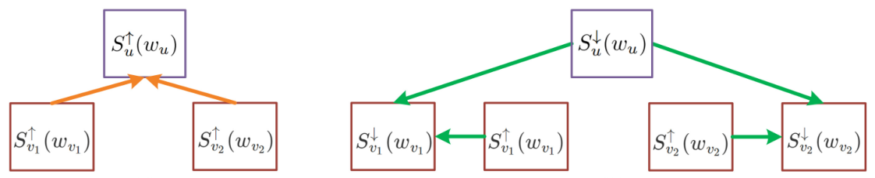
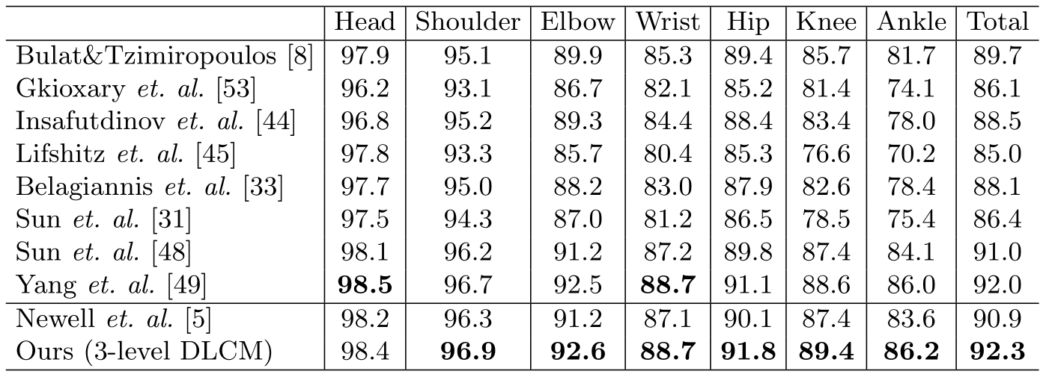
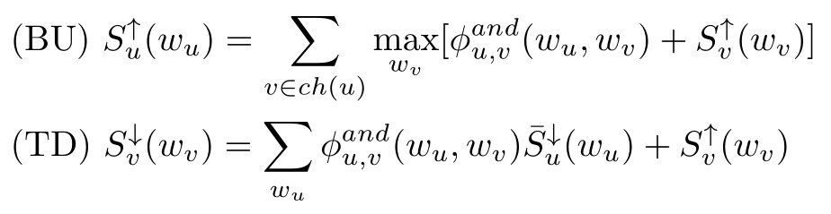
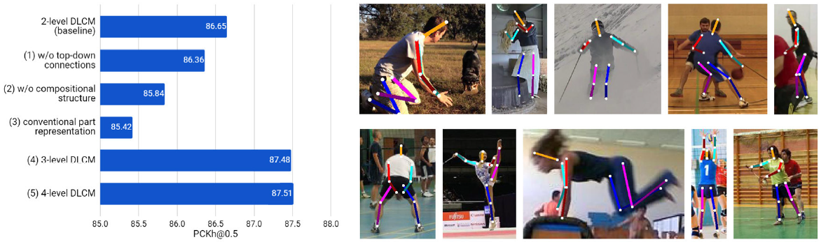
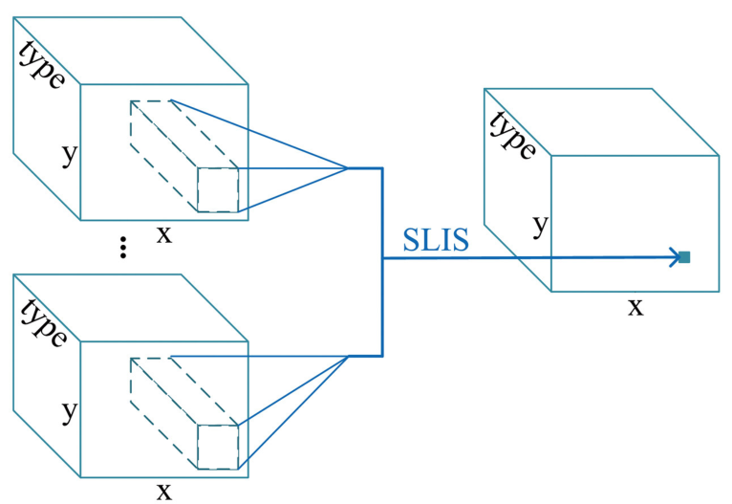
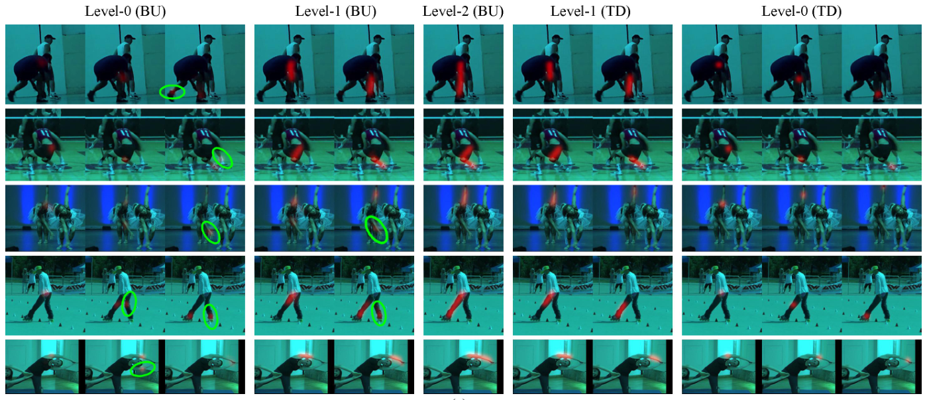
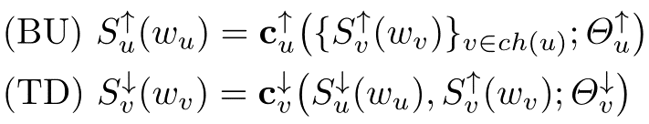
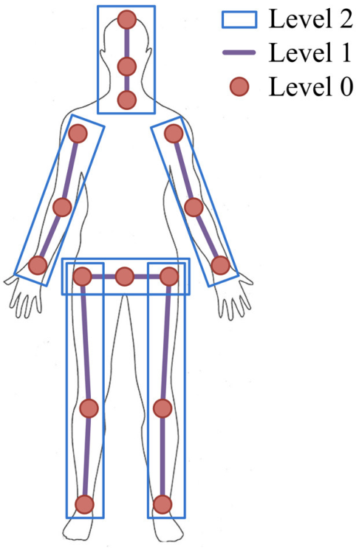
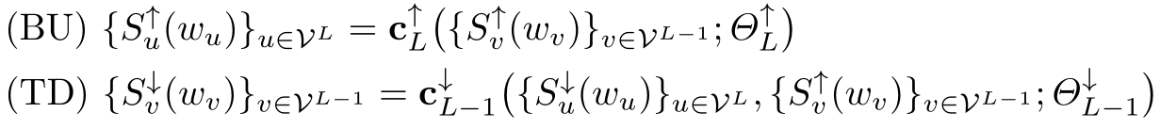
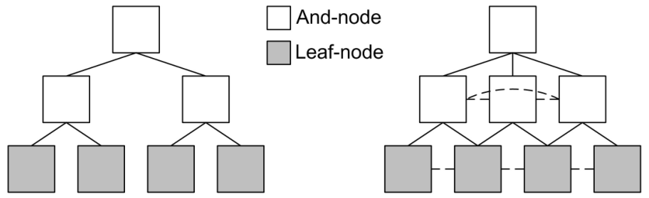
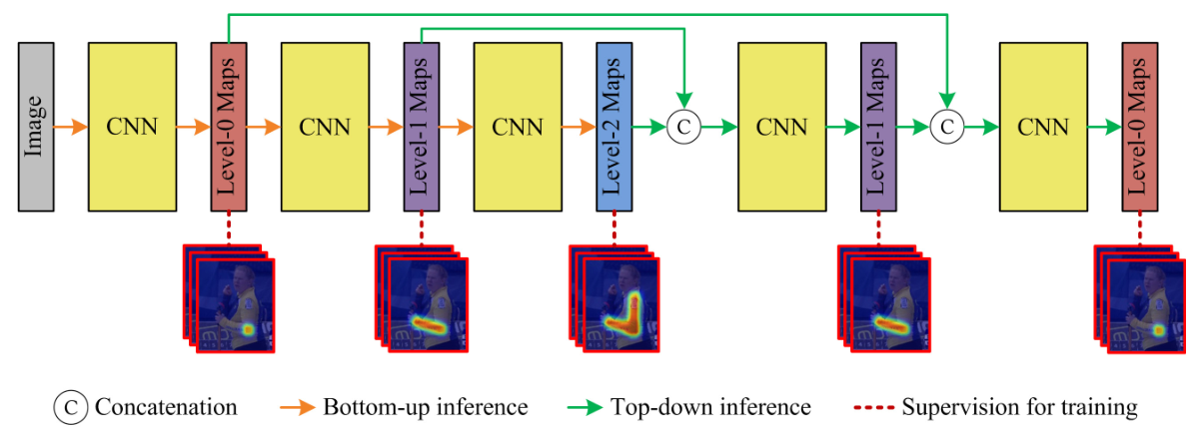
Deeply Learned Compositional Models for Human Pose Estimation
Wei Tang, Pei Yu and Ying Wu
Overview
Proposed Approach
Experiments
Compositional inference
Comparisons of PCKh@0.5 scores on the MPII testing set
Motivations
Spatially local information summarization (SLIS)
There are problems with prior compositional models for human pose estimation
Unrealistic assumptions on subpart-part relationships
Exponentially large state spaces for higher-level parts
Approximate inferences not well understood
Child parts should not be far away from their parents → spatially local
MAX and AVE poolings acted on score maps → information passing
Contributions
The first attempt to explicitly learn the hierarchical compositionality of visual patterns via CNNs
A novel part representation to compactly encode the orientation, scale and shape of each part and avoid large state spaces
A novel network architecture with a hierarchical compositional structure with bottom-up/top-down inference stages across multiple semantic levels
Model compositional inference functions with CNNs
Part sharing and higher-order potentials:
z
Network architecture
Background: Compositional Models
Compositional structure: 3 semantic levels
  Parts sharing a common parent are connected to each other
CNNs: hourglass modules
Bone-based part representation
Embed type information into score maps
  State variables only denote locations
Represent each part with its bones
  Gaussian kernels along part segments
The score function of a basic compositional model

